Slide 1

Importance of Privacy in Distributed Systems

Slide 2



Who Am I?
Justin Ehrenhofer
Organizer of the Monero Community Workgroup and the Monero Malware Response Workgroup
Board Member of MAGIC (https://magicgrants.org)
Previous experience in cybersecurity
Interested in distributed privacy systems
Senior moderator of r/CryptoCurrency with over 700,000 subscribers

Slide 3
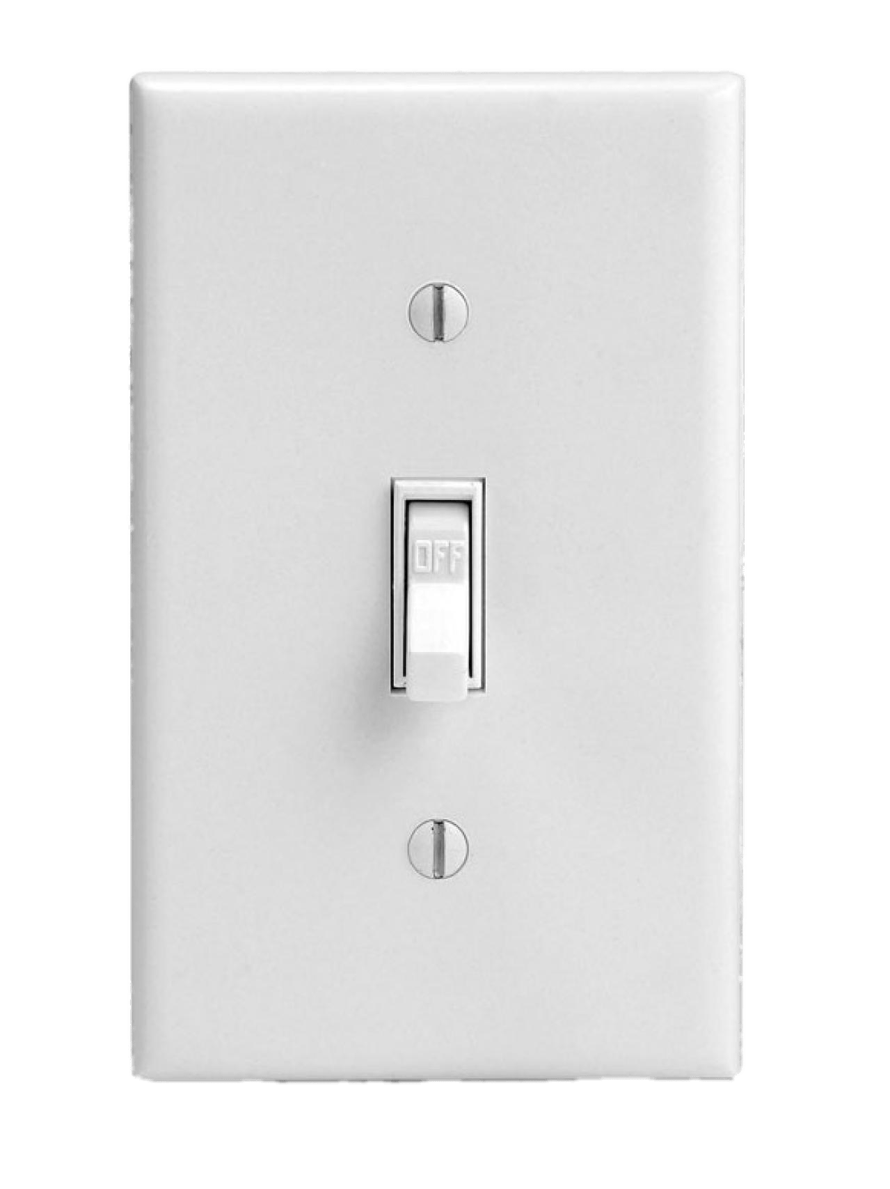
Privacy Isn’t Binary
What most people think privacy is:

Slide 4
Privacy Isn’t Binary
What privacy actually is:
Perfect Privacy
Perfect Transparency

Slide 5

Riccardo “fluffypony” Spagni Monero Core Team Member
Privacy isn’t a thing that you achieve, it’s a constant cat-and-mouse battle.
Notes:
https://www.wired.com/story/monero-privacy/

Slide 6
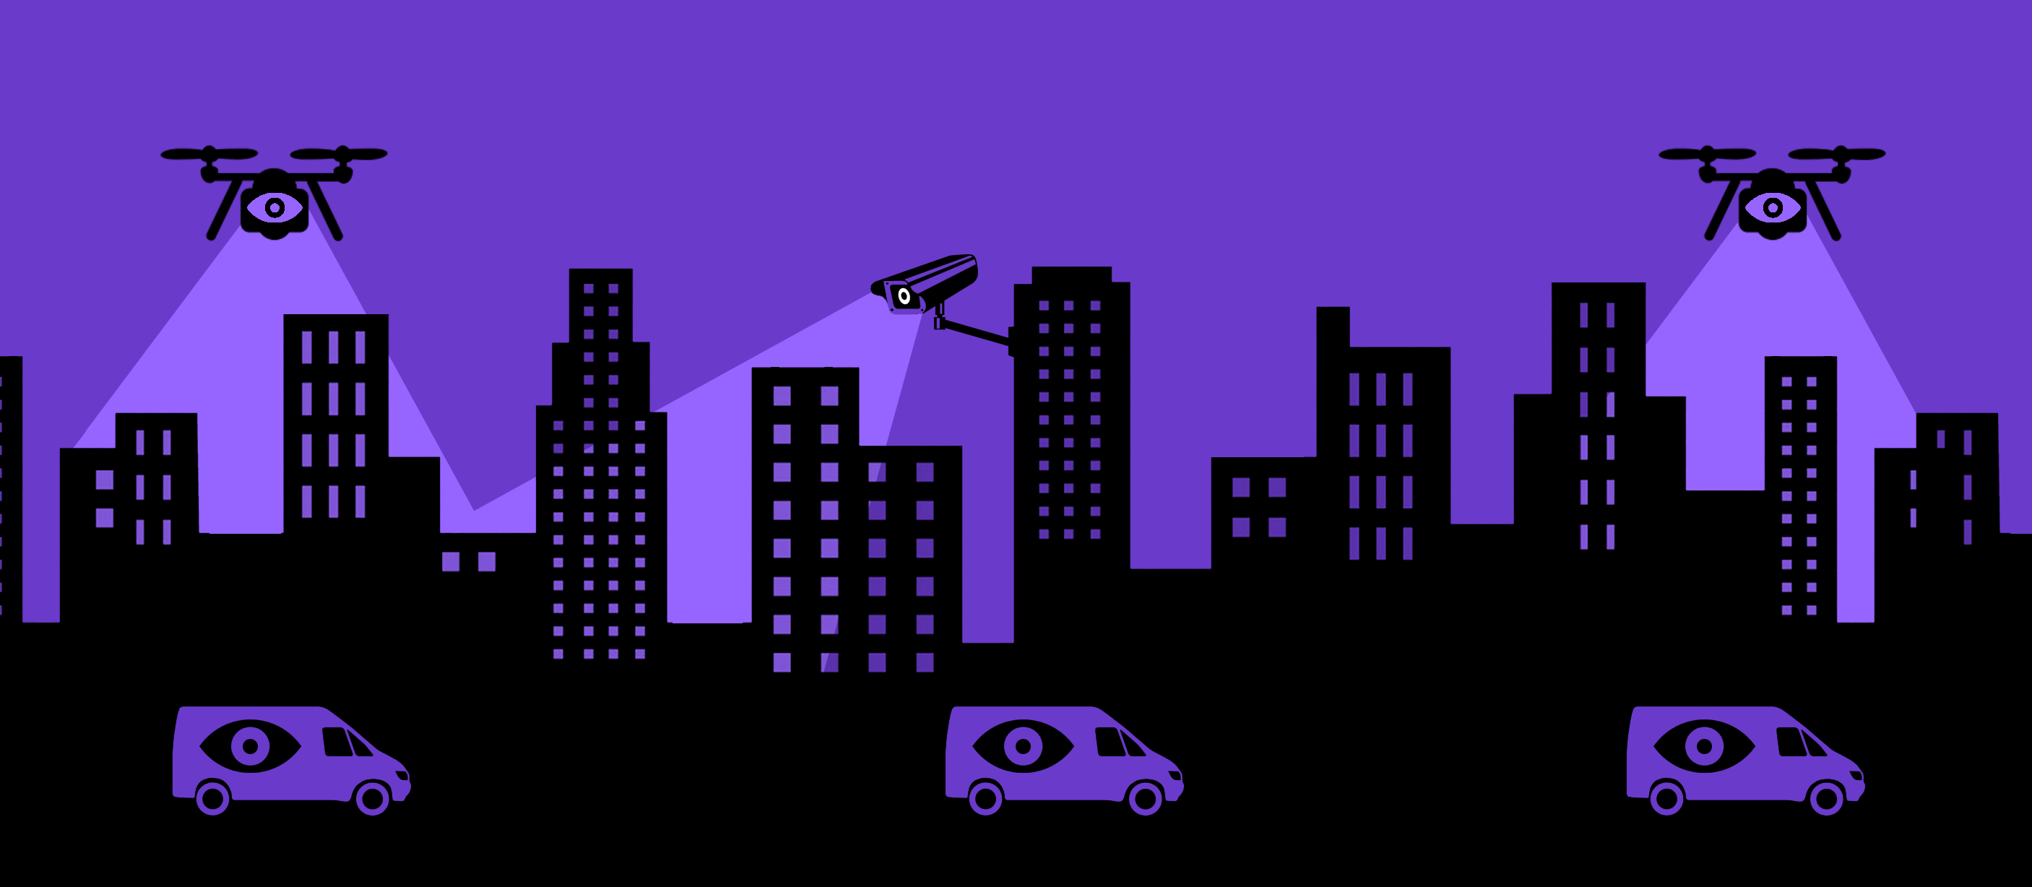
It All Comes Back to a Threat Model
Image courtesy of EFF

Slide 7
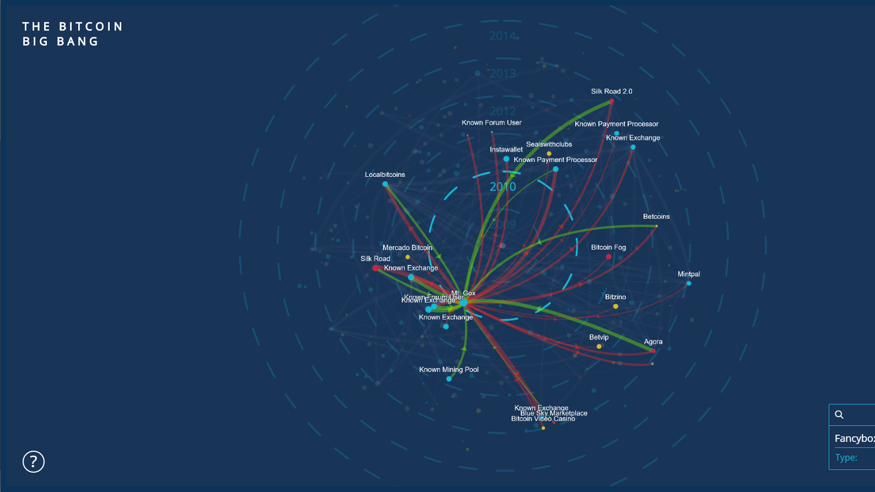

Bitcoin is NOT (very) private!
Notes:
Bitcoin is not private! In fact, it is perhaps the most transparent money system ever made. Everyone in the world can see a history of the following:
The amount of money in a wallet
Where the Bitcoin came from
Where the Bitcoin went
This visualization shows the transfer of Bitcoin from large accounts to others. It is a visual representation of transfers of Bitcoin.

Slide 8

Transparency Has Implications on People and Business
Sources
Expenses
$
Balances
Employer info
Family and friend connections
Business suppliers and upstream business connections
Fungibility
Political and religious affiliations
Health data and doctors
Customers and downstream business connections
Everyday purchasing habits
Employees
How much money you have
Targeted crime against wealthy individuals and companies, especially in cases of malware and robbery
Willingness to pay suppliers and charge customers
Willingness to pay employees

Slide 9
Tools Can Be Added to Transparent Systems. Their Effectiveness is Complicated
Probably not; it’s complicated
MIXER
TUMBLER
zkSNARK
zkSTARK
Highly transparent
Could be effective

Slide 10




Mixing Isn’t Very Effective
Notes:
When people started realizing that Bitcoin is not private, they tried adding things on top of Bitcoin so some people could have privacy. This is traditionally done with a Bitcoin mixing or CoinJoin approach. Several people take their Bitcoin and send it to a centralized server. This centralized server then gives a random Bitcoin from among those received back to the users. Ideally, this could provide some untraceability, since the origin of the received funds is ambiguous. However, there are several fundamental issues with this type of approach.

Slide 11
Mixing Isn’t Very Effective
Notes:
The vast majority of people who use an optional system that costs extra which you need to go out of your way to use are people who have tainted coins. Tainted coins are coins that are known to previously be used for illicit purposes. An insignificant number of people pay money to mix clean coins. Thus, mixers do not work very well at providing plausible deniability. Instead, they make you stand out, since it makes it look like you are doing something wrong. Mixing itself is a shady act.

Slide 12
Mixing Isn’t Very Effective
Notes:
Second, you add a level of trust to the system. While Bitcoin is trustless, you need to trust the mixer you use with CoinJoin. They may choose to keep a history of the transaction information, and the people who use the service will never know. People must trust that the mixer does not act maliciously, which is a systemic risk with mixing services. In an ideal private system, you should not have to trust anyone else with your privacy.
Finally, from a convenience perspective, it takes a long time to mix coins, since you need to wait for other participants to mix with. If you plan to mix a large number of coins several times, it can take days or weeks. Few users will go through this effort.

Slide 13
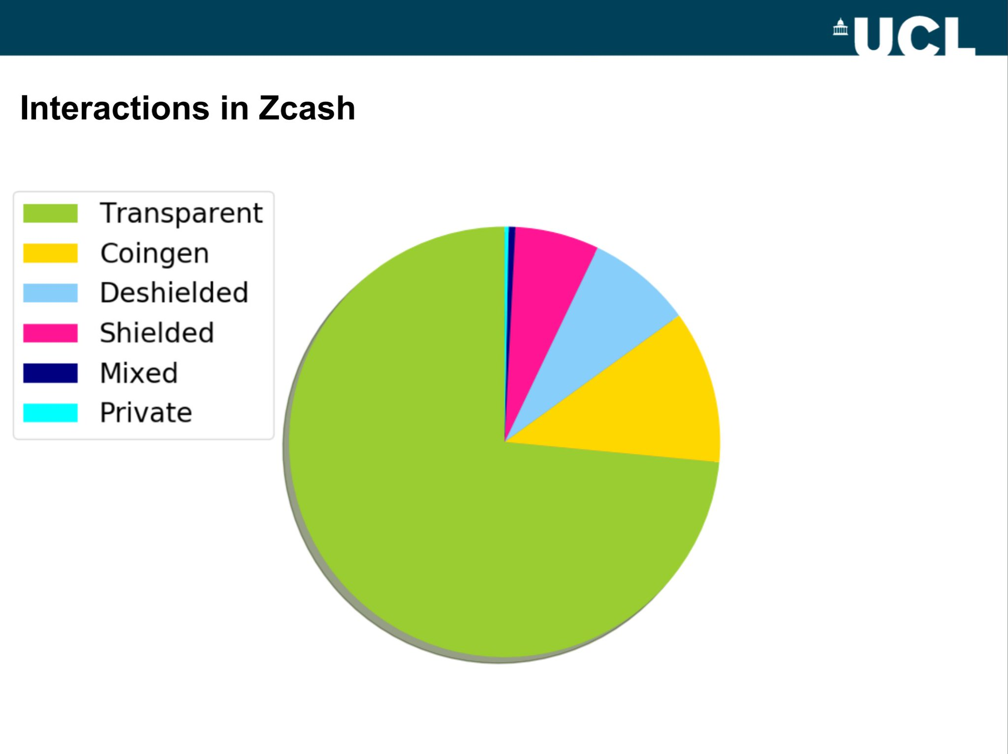
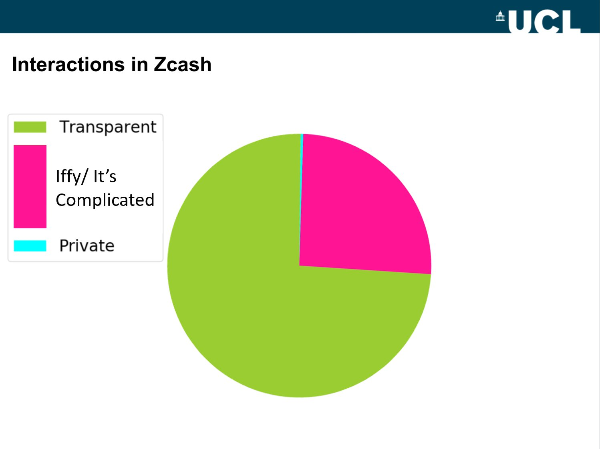
Effectiveness of Optional Extremely Private Systems is Complicated

Slide 14

Even Mandatory Privacy Isn’t Perfect
Some things Monero has done to increase its privacy in the last few months:
Increase ringsize from
Mandatory ringsizes
Better remote node metadata protection
Blackball tool
Churning recommendations
3
5
7
11

Slide 15




Privacy Matrix
Accessibility & Usability
Theoretical Maximum Privacy

Slide 16
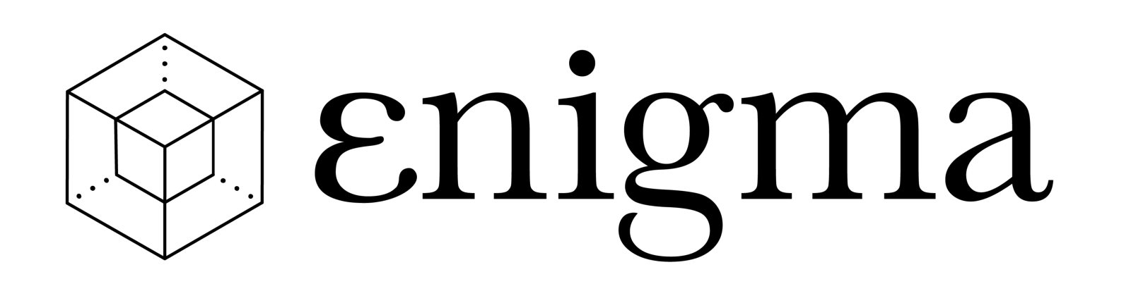

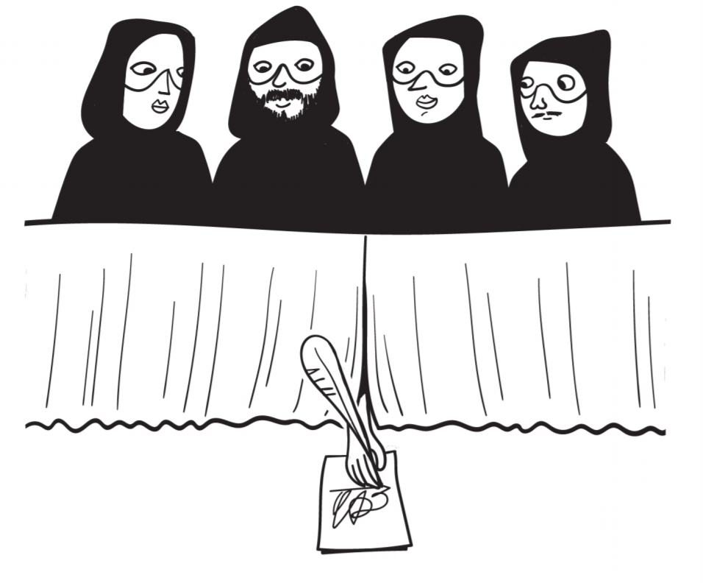
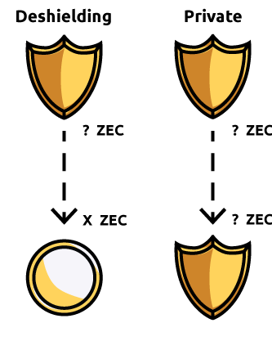
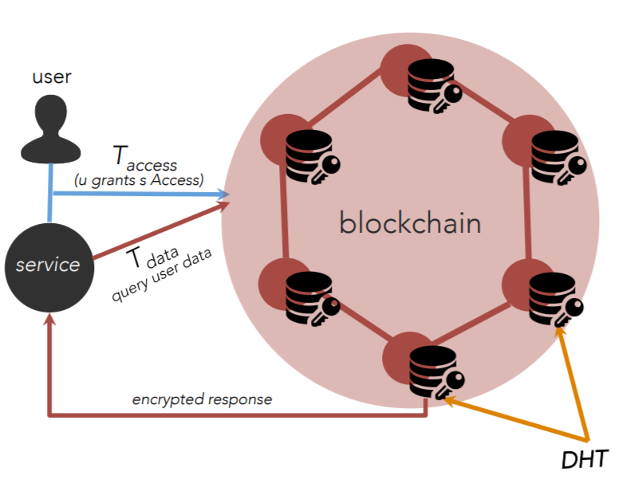
Privacy Solutions to Consider
Coming SoonTM
Ring signatures
RingCT
Stealth addressess
File encryption on server
Hash stored on blockchain
zkSNARKs
zkSTARKs

Slide 17
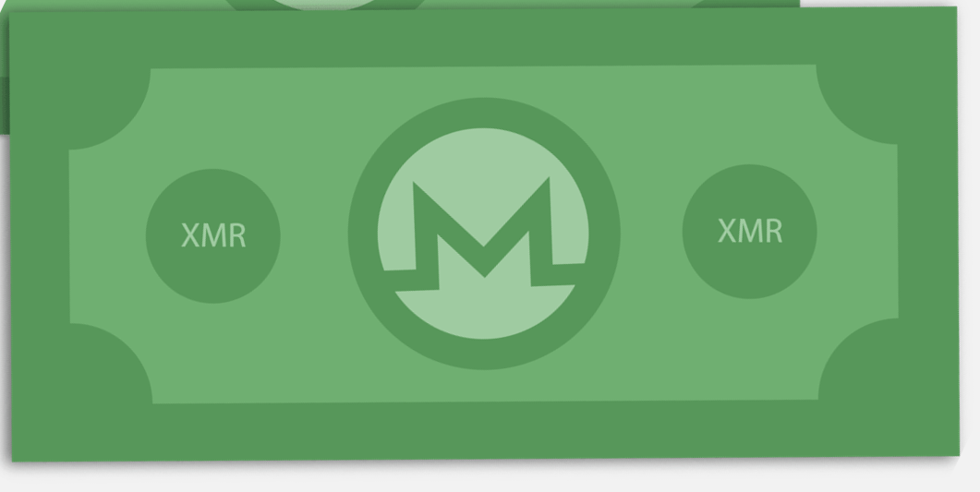
Fungibility
=
TAINTED
≠

Slide 18
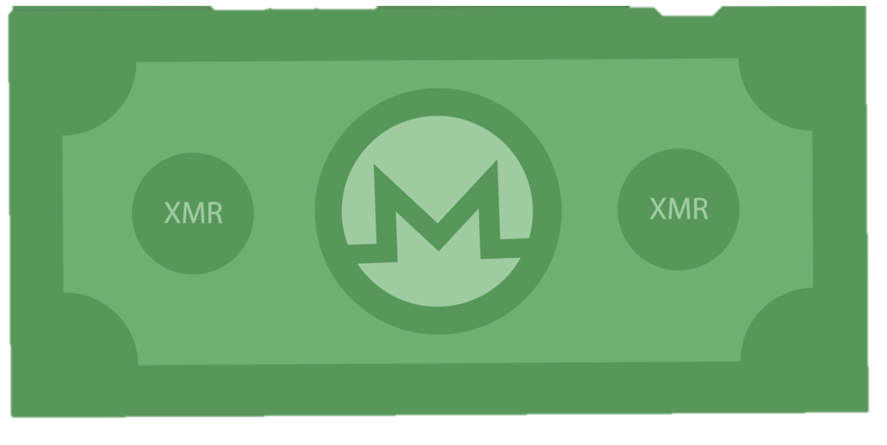
Fungibility

Slide 19
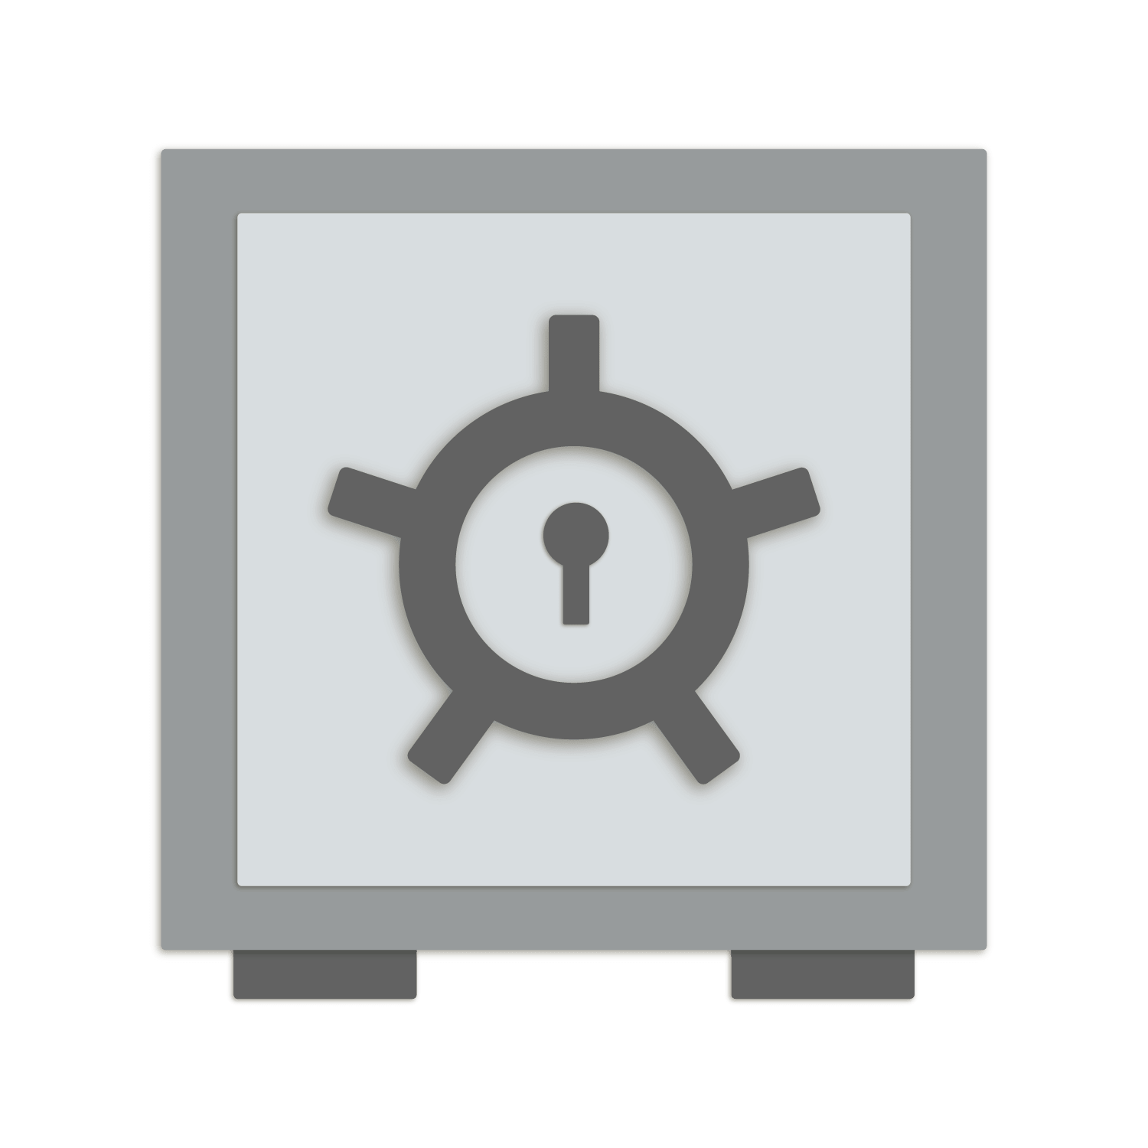


Summary

Slide 20



Thank You!
MAGICgrants.org
u/SamsungGalaxyPlayer
@JEhrenhofer
justin@ehrenhofer.org
5137 9F1B A7FC 2D05

